Slide 1

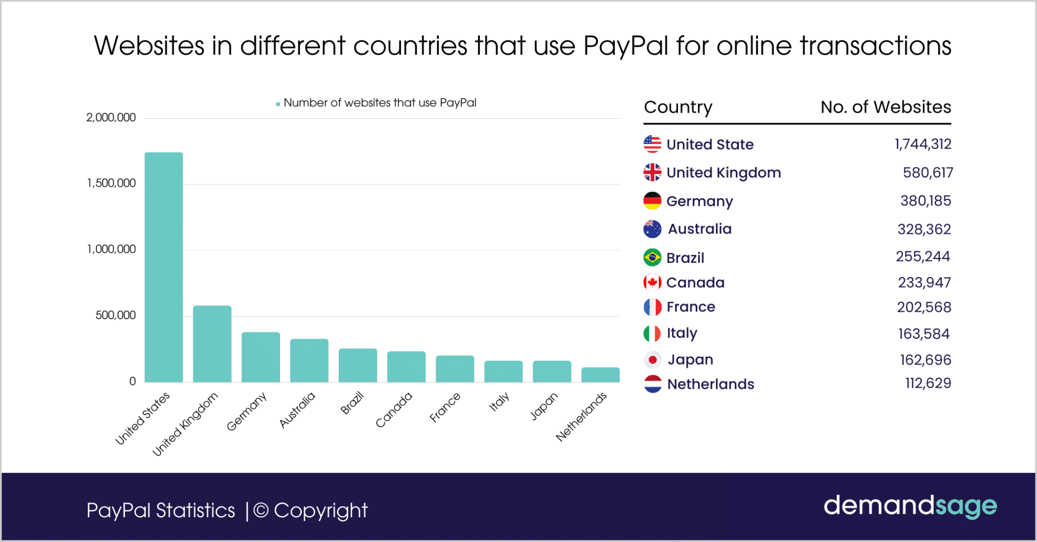
Did you know that PayPal relies on Google Cloud's networking to enhance global transactions?
Notes:
PayPal uses Google Cloud's robust and secure network to process millions of transactions daily, ensuring speed, security, and reliability for its users worldwide.
This example emphasizes Google Cloud's ability to handle mission-critical financial operations at scale.

Slide 2
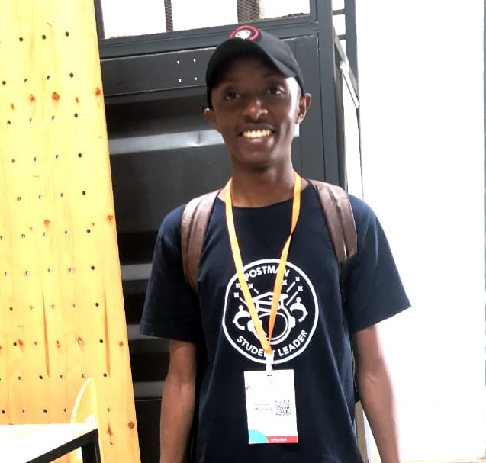

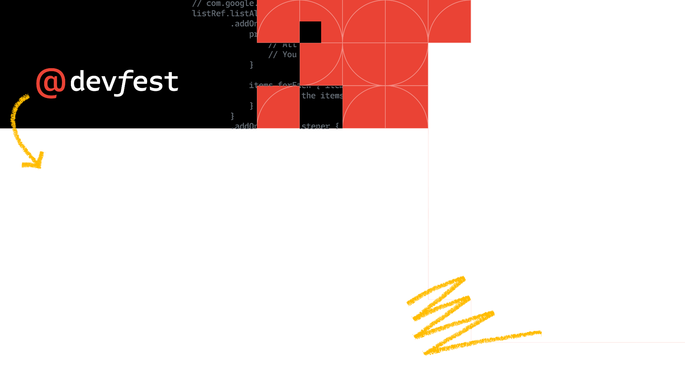


Networking Fundamentals in Google Cloud
Google Cloud Skills for Africa
2024
Thur 21st Nov, 2024
Samuel Macharia - Cloud Engineer
@engeniusam
Notes:
I am Cloud Engineer and a community advocate, as far as Google is concerned last yr GDSC Lead at UEAB and currently a mentor in the Google Cloud Skills for Africa 2024. I do enjoy inspiring others through what I learn in tech with todays focus on the Google Cloud Platform. Feel free to connect with me on LinkedIn(Samuel Macharia) and on X and to ask any questions on GCP.

Slide 3

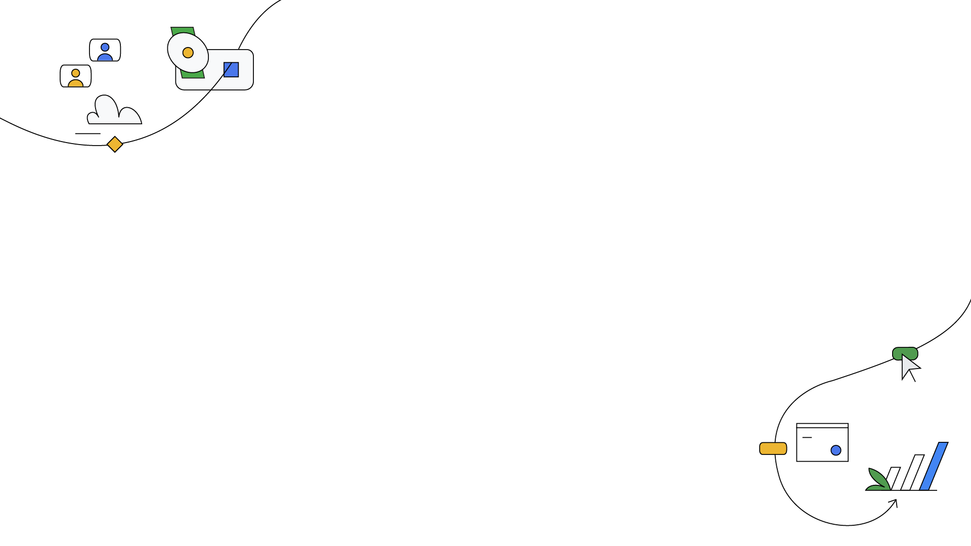
Google Cloud Networking Technologies
Virtual Private Cloud (VPC) - A private network for your resources in Google Cloud.
Compute Engine: Provides virtual machines (VMs) to run your applications.
Load Balancers: Distribute traffic efficiently across resources.
Firewall Rules: Control traffic to and from your VMs.
More GCP Technologies: Cloud CDN, Cloud Nat, Private Google Access, Cloud Armor
Notes:
1. Virtual Private Cloud (VPC)
A private network for your resources in Google Cloud.
Auto-mode VPC: Automatically creates subnetworks in each region.
Includes firewall rules to control access to and from resources.
2. Compute Engine
Provides virtual machines (VMs) to run your applications.
VMs are used in networking labs to simulate real-world scenarios.
3. Load Balancers
Distribute traffic efficiently across resources.
Network Load Balancer: Handles TCP/UDP traffic.
Application Load Balancer (HTTP(S)): Manages web traffic for applications.
Internal Load Balancer: Manages internal traffic within a VPC without exposing resources publicly.
4. Firewall Rules
Control traffic to and from your VMs.
Allow or deny traffic based on IP ranges, protocols, and ports.
These technologies form the foundation of networking in Google Cloud, enabling secure, scalable, and efficient communication between resources. Let me know if you need further elaboration or visual materials!

Slide 4
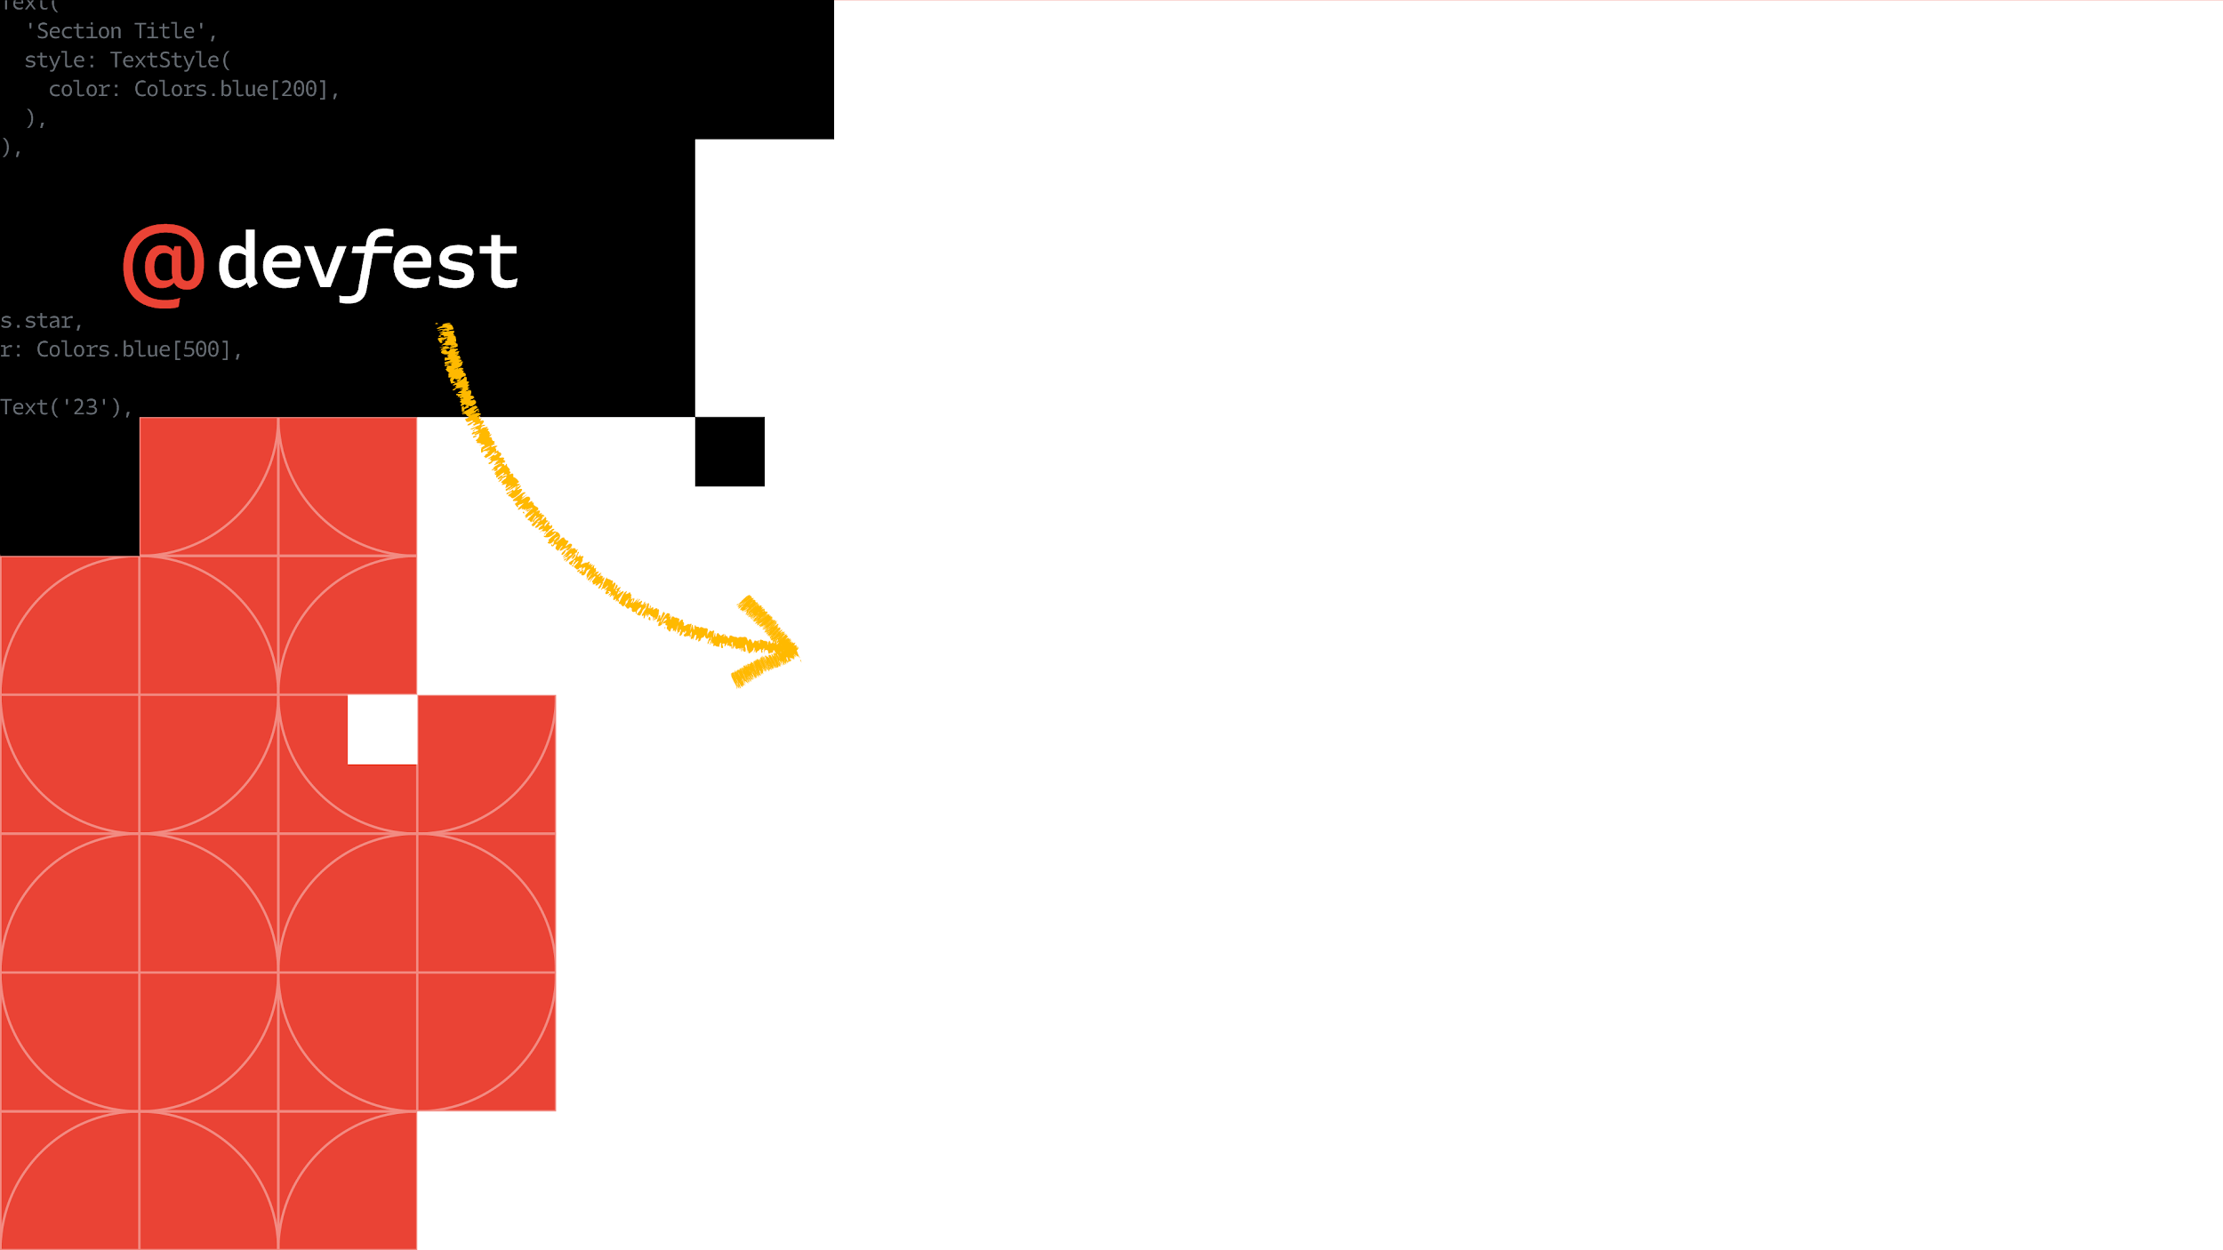
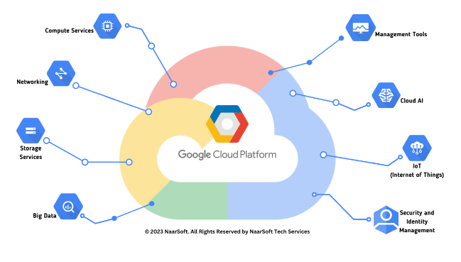
Google Cloud Skill Badge Achievement
Google Cloud Skills for Africa
Completing the course grants a digital skill badge for Networking Fundamentals proficiency in Google Cloud.
Shareable badge for professional networking platforms like LinkedIn.
Demonstrates competency with Networking in Google Cloud Technologies.
2024
Notes:
Skill badges issued by Google Cloud recognize technical expertise and proficiency in specific cloud technologies. Completing this course and earning the badge can boost credibility and enhance career prospects for cloud enthusiasts and professionals.
Whether you are interacting with VPC, Compute Engine, Network Load Balancer, Application Load Balancer, Internal Load Balancer, Firewall Rules.- the badge you earn from these labs comes in handy to that recruiter who is interviewing you for that cloud role.

Slide 5

Demo Time
Networking Fundamentals in GCP:https://tinyurl.com/GCPNetworking

Slide 6


